Slide 1

Tax Optimization for
Salaried Employees
Presented by: CA Sudhir Kaushik Co-founder TaxSpanner.com
FY 2013-14
Notes:
A very good evening to all of you. I am Sudhir Kaushik, Co-founder, TaxSpanner.com and am here today to interact with you on a topic, which most of us not only find boring, but also avoid talking about – Tax. And it’s quite funny that even the agenda of this workshop revolves around “avoiding tax”.

Slide 2
Agenda
About TaxSpanner.com
Why is Tax Filing and Tax Planning Important?
Income Tax Computation
Understand Your Tax Ratio
How to optimize Tax Ratio
Sources of Income Exempted from Tax
Permitted Deductions under Income Tax Laws
Amendments applicable from FY 2013-14.
Illustrations for Other income and cap gain tas saving
Lifetime Tax Treatment of Investment Products - The EEE model
9 reasons for getting tax notice and safeguard against them by Taxspanner
Notes:
So, we will start with talking a little bit about us – what TaxSpanner does and what it stands for. Then, we will move to a list of “Don’ts” based on our INDIA TAX RATIO REPORT of tax-filing patterns of more than 200,000 salaried individuals in India. After we are done with that, we will move into that part of the presentation which all of you’re eagerly waiting for. How do we save the money that we lose as tax every year? We delve into this and identify where we lose this money, and will conclude with the selection of tax efficient investments to take to avoid paying tax more than we are supposed to. Last but not the least, reasons of getting “Tax Notice”.

Slide 3
About Tax Spanner.com
Founded in 2007 by experienced management comprising CA, MCA & MBA Largest E-Return Intermediary of Income Tax Department,
Highly Secure and Totally Confidential
Providing Accurate Information on Tax Laws to Individual, Corporate & Media
Trusted by Individuals from more than 500 corporate for Tax filing & Saving
Recommended by Top Employers (SAP, Accenture, HCL, Genpact, iGate etc. ),
Banks - SBI, PNB, YES, Canara, Syndicate, SCB, DhanLaxmi, SIB etc.
Brokerage houses- HDFC Securities and Axis Direct, auto cap-gain computation
Payroll managers- AON Hewitt, Allsec, auto – upload form 16,
Notes:
So, what does TaxSpanner do? TaxSpanner applies its technological expertise to the income tax needs of individuals in India – the result is the most user-friendly I-T solutions online. TaxSpanner has been helping Indians file their Income Tax Returns online for more than six years now. In 2011, we became the largest e-Filing company in India in terms of the number of e-returns filed through our platform. IT Dept has authorized us for the same. Almost every top employer, bank, brokerage and payroll has trusted TaxSpanner for the ITR filing of its employees/customers and that’s because when it comes to Confidentiality and Compliance, TaxSpanner is No.1 (Mint says that, Money Today says that). With excellence in service delivery, we at TaxSpanner also strive for constant innovation through thought leadership. Our experts continuously study how taxpayers behave, and how their lives can be made simpler. In the pursuit of this very goal, we recently launched verified return with 26 AS, auto –upload of equity transactions, identified 9 reasons of getting tax notice this season and MRS (MyReturnStatus) to safeguard from tax notices and penalties.

Slide 4
Why is Tax Filing and Planning Important
Tax Filing: Why is it Important?
Tax filing is mandatory, if gross total income before deduction exceeds Rs 2 Lakh
Useful (and often, mandatory) when applying for a loan
Tax Return Filings are needed as proof when applying for visas
For avoiding tax notice & penalties up to 300% due to non-filing
For claiming refund of excess tax deducted
For claiming relief of taxes paid outside India & declaring foreign assets
Tax Planning: Why is it Important?
Optimize your Tax Outflow – Minimize expense on Income Tax
Offers the opportunity to invest in long term wealth creation instruments
  Many of these tools also offer tax exemption at Investment, Growth and Maturity, thereby offering efficient wealth creation opportunities
Notes:
So, what does TaxSpanner do? TaxSpanner applies its technological expertise to the income tax needs of individuals in India – the result is the most user-friendly I-T solutions online. TaxSpanner has been helping Indians file their Income Tax Returns online for more than four years now. And this year, we became the largest e-Filing company in India in terms of the number of e-returns filed through our platform. Almost every top employer has trusted TaxSpanner for the ITR filing of its employees and that’s because when it comes to
Confidentiality and Compliance, TaxSpanner is No.1 (Mint says that, Money Today says that). IT Dept has authorized us for the same.
With excellence in service delivery, we at TaxSpanner also strive for constant innovation through thought leadership. Our experts continuously study how taxpayers behave, and how their lives can be made simpler. In the pursuit of this very goal, we recently identified the top 10 tax filing mistakes people made this season:

Slide 5
Income Tax Computation: Salaried Class
Gross Income = Income From Salary + Other Income
1
Other Income = Income from House Property + Income from Capital Gain + Income from other sources including Interest Income
1a
Taxable Income = Gross Income –Exempted Income - Deductions
2
Maximum Opportunity for Saving Taxes
Exempted Income = HRA + LTA + Conveyance Allowance + Medical Allowance + interest on home loan
2a
Deductions = Under Chapter VI -A viz. Sections 80 (C)/CCD(1)/CCG/D/ G/ TTA
2b
Tax Computation as per prevailing Income Tax Slabs
3
The Tax Payable by an Individual depends not only on his Level of Taxable Income but also on the Deductions Utilized (as allowed by the law)
Notes:
We want to briefly touch on the income tax formula for calculating tax liability.
The Gross Income minus the tax saving investments made gives the Net Taxable Salary which will be taxed based on an individuals tax slab
Gross Income will include Basic Salary, HRA, LTA, Bonus, Medical etc
Amount invested in PF,PPF, NSC, LIC, ELSS etc will qualify as deductions
2b. Deductions are the best opportunity for salaried class employees to save taxes. It also leads to medium-long term wealth creation
2a. Max. Exempted Income is a function of your salary structure and is based on your organization’s compensation policy. It is worth noting that exempted Income is based on actual expenses and hence it is recommended that one does not make unnecessary expenses just to save taxes
All Exempted Income and Deductions claimed under 2a. and 2b. are subject to proofs submitted and the Assessing officer may require you to furnish details of these at the time of scrutiny (if your case is selected for scrutiny)

Slide 6
Income Tax Slabs: FY 2013-14
Income Slab | Tax Rate | Tax Liability
Up to Rs. 2,00,000 (Male & Female < 60 Yrs Age) | NIL | 0
Rs. 2,00,001 – Rs. 5,00,000 | 10% | 10% * (Taxable Income – 200,000)
Rs. 5,00,001 – Rs. 10,00,000 | 20% | Rs.30,000 + 20% * (Taxable Income – 500,000)
Rs. 10,00,001 and above | 30% | Rs.130,000 + 30% * (Taxable Income – 1,000,000)
Basic exemption limit is Rs 2,50,000 (instead of Rs 2,00,000 ) in case of Male & Female >60Yrs Age and Rs 5,00,000 in case of Male and female >80Yrs Age.
Education cess of 2% and Secondary & Higher Education Cess of 1% are levied on the tax amount computed above
Notes:
Before we start the discussion about optimizing the tax outgo let’s have a quick look the basic exemption and tax slabs for the current financial
Unlike last year there is no difference in the basic exemption available for both male & female under age 60 which is up to INR 2,00,000 i.e. no TAX
Income between INR 2,00,001 to INR 5,00,000 is taxed at the rate of 10%
Income between INR 5,00,001 to INR 10,00,000 is taxed at the rate of 20%
Income between INR 10,00,001 and above is taxed at the rate of 30%
2% of Education cess and 1% of secondary and higher education cess is levied

Slide 7
TAX RATIO = Total Tax Paid/ Gross Income
%
Have you calculated your Tax Ratio?
Notes:
Calculate yours and compare with the smart taxpayers to see the scope of further saving in your income bracket. Are you a Smart Taxpayer?
Longer working hours, more travelling time, insufficient work force, exhausting deadlines and so on... There are so many things today’s working professionals endure just to ensure more income and the affordability of a good lifestyle. Each individual works smart and hard to achieve a fatter pay check, more profit on investment and greater savings. However as the financial year end approaches, the income you are left with after paying taxes just does not seem enough.
There are a few reasons for the same, most of them are related to poor tax planning, investment in low yielding policies and schemes, and lack of awareness. It seems that when it comes to tax matters, we are not as smart as we think we are.

Slide 8
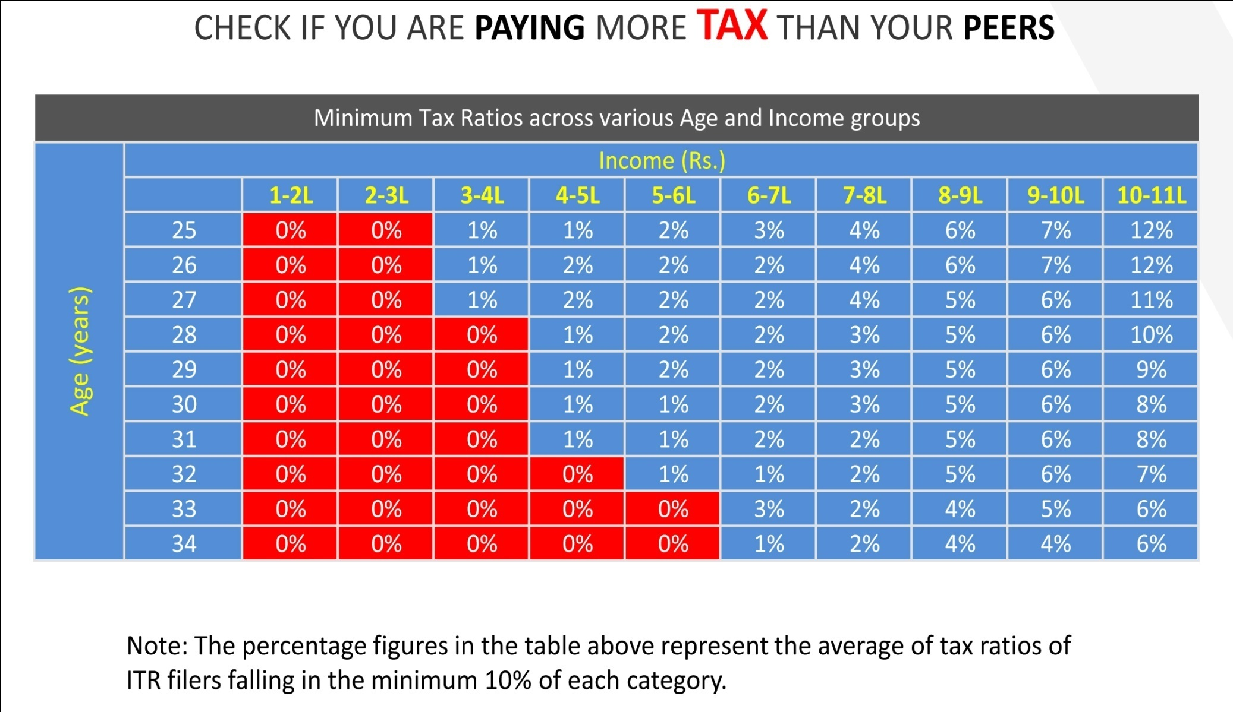
Tax Ratio: How are you placed?
Notes:
Measured in percentage, it can be easily calculated by dividing your tax paid and salary. According to a study conducted by TaxSpanner, the Tax Ratio of taxpayers with salary Rs. 7 lakh and 29 years of age ranges from 1% to 4%, thereby implying that some taxpayers in this group are paying just Rs. 7,000 (1%) as tax and some are paying Rs. 28,000 (4%) as tax. Ideally, if every individual is tax efficient in this group, then he/she should have tax ratio of 1% only! Similarly Rs 60000/- (6%) for Salary Rs 10 lakh.
You may want to calculate your tax ratio right now and see how well you are doing with optimization. There are a few reasons for the same, most of them are related to poor tax planning, investment in non-tax efficient schemes, and lack of matching investment to financial goals. It seems that when it comes to tax matters, we are not as smart as we think we are.

Slide 9
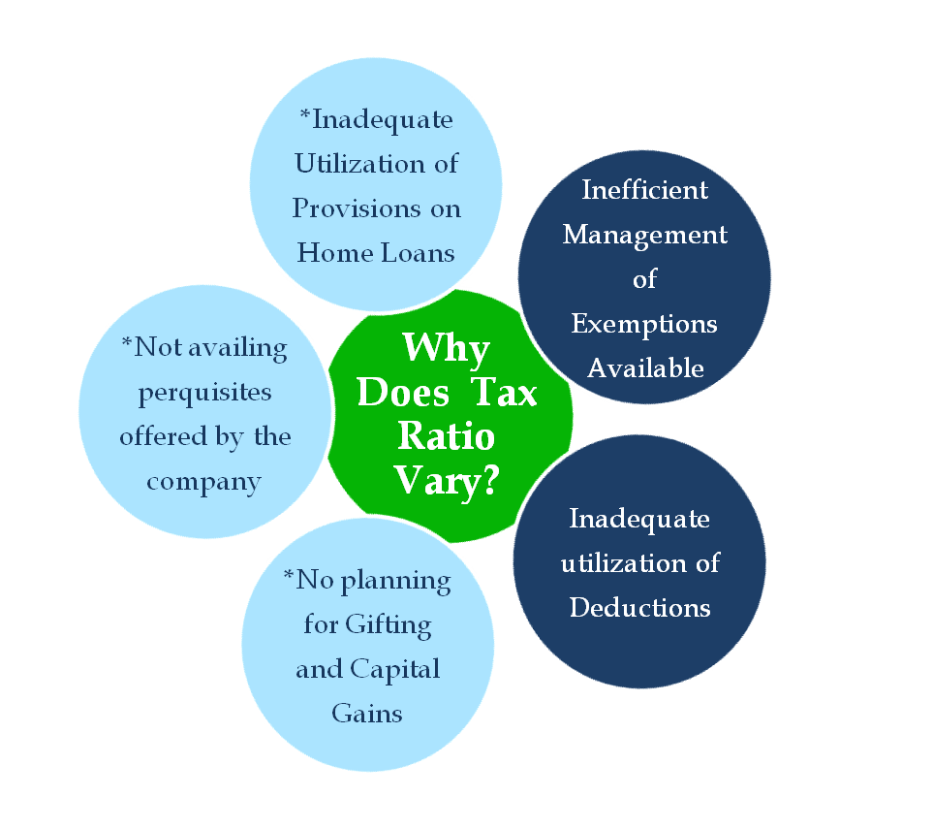
Why is My Tax Ratio High ?
Key to Optimizing Tax Liability for a Salaried Individual:
Efficient Management of Exemptions
Maximum Utilization of Deductions
Note:
* Support of a qualified Tax Consultant/ Chartered Accountant is recommended
Notes:
So, the question we arrive at is that why is your tax ratio different from that of your peers.
Even at the same salary, you and your peers may have a different basic pay. Salary packages have many components. There can be allowances and perquisites that you are not claiming, but your peers are. The bottom line is that there are a whole lot of tax benefits which you can claim based on your requirements.
Then, there are deductions. Our study tells us that 64% of tax payers do not even exhaust the total limit of deductions they can claim under section 80C.
Then, there are people who will, due to absence of professional help, invest in instruments earning taxable income… and there are tax payers who make sure that they take full advantage of exempt incomes which are earned through mutual funds, tax free bonds or even gold and land.
How many of you own a home? And how many of you took a home loan to buy it?
How many of you are still waiting to make it to that sufficient corpus to buy that dream home?
So, here we have another example of why tax ratio could vary. There are people who have grabbed the opportunity of buying a home, which entitles them to tax benefits embedded in home loan. On the other hand, many of you wait for that right moment, which actually keeps on becoming distant since property rates increase at a rate faster than our incomes.
Similarly, there are gifts and capital gains which significantly influence what your tax ratio is.

Slide 10

“Minimizing” Tax Liability
Use Provisions of the Income Tax Act to Reduce Tax Liability
Pay the minimum that the law requires
There is nothing Immoral or Unethical about Saving Taxes
Law allow citizens to save taxes under the various provisions of the Income Tax Act
Notes:
While these were some of the common mistakes in ITR filing, one mistake that TaxSpanner observed in the ITR data and felt that it required a systematic solution was about the very amount paid as tax. Majority of tax payers are not keeping their tax outgo as low as it can be. Secondly, they are paying more than what the law demands. The two questions you need to ask here are:
How can I keep my taxes as low as possible?
How much tax does the law demand?
The conclusion being that there is need for optimization. People need to optimize their tax outgo. Believing that they can not save tax is not an option, because there is always a way. The same law that provides for tax payments, also provides for tax benefits that help tax payers to claim deductions and exemptions.
Secondly, even if you are saving tax, you’ve got to be positive about saving more. Being optimistic is essential to the process of optimization. So, while the glass is half full, you need to believe that you can ensure that there are no empty spaces left.

Slide 11
Exempted Income
Provident Fund:
Statutory Long Term Savings Scheme: Employer and Employee each contribute 12% of basic salary
    Employer’s contribution is exempt from taxes, hence does not reflect in Form 16
    Employer’s contribution over 12% of basic salary treated as employee’s income
    Employee’s contribution up to Rs. 1,00,000/- is allowed as deduction u/s 80C
House Rent Allowance
Least of the following three is exempt:
      HRA received/ 50/40% * of Basic Salary /Rent paid minus 10% of Basic Salary
Notes: 50% in case of Delhi, Chennai, Kolkata, Mumbai 40% in other cases
We will discuss this with the help of illustration later
Medical Reimbursement: Reimbursements for general medical expenses
Up to Rs 15,000 p.a. against actual supporting documents
Actual bills of chemist, doctors’ fee, tests incurred for self, spouse, children, dependent parents, brother or sister
Notes:
House Rent allowance is a very important part of your CTC. And what is more important is that you tune your HRA to the actual rent paid by you, be it more or less. For instance, if you are paying 18,000 as rent, but are receiving only 12,000 as HRA, make it a point to get your salary restructured to increase the amount allocated to the HRA component. This will bring down your taxable income significantly. Two more things: even if you are living in the house owned by your parents, you can still claim HRA. Of what I know, how it usually works in most of the families is that everybody contributes to the monthly spending – be it on grocery, electricity or other utilities. To take full advantage of this contribution, you can contribute this amount as rent paid to your parents and claim it as HRA.
You can claim both HRA and home loan benefit if you are living in rented property and have taken a loan for constructing a house in a different city. In fact, both these benefits can be claimed even if rented accommodation and owned property (self occupied) is located in the same city, subject to some conditions (here you can give example of a condition).
2. If you incur expense on your family’s health, you are entitles to tax benefit. You can claim tax free reimbursements of Rs 15000p.a. on submission of actual bills of chemist, doctor, tests incurred for your family (spouse, children, dependent parents , brother or sister) Generally, there is a misconception that medical reimbursements are dependent on the number of working days. However, the law has not restricted its purview to the number of working days. As per law for general medical reimbursement, Rs 15000 is the maximum tax break that an individual can avail against actual supporting documents.

Slide 12
Exempted Income (Contd...)
Transport Allowance: Allowance for commuting between workplace to residence
Rs 800 p.m. is exempted as Transport Allowance
No supporting document is required to be submitted for claiming this exemption
Conveyance Allowance: Allowance for conveyance for performance of duties
Exempt to the extent of amount spent or amount received which ever is lower
Allowance should be used for performance of duties
Phone Bill Reimbursement
Reimbursements by employer for telephone expenses incurred by you
Note 1: Telephone allowance is fully taxable, only reimbursements are tax free
Note 2: The claim should be supported with bills
Food Coupons
One or Two “Meals” (i.e. breakfast, lunch, dinner) per day during working hours could be considered as reasonable and Rs. 50 per meal is exemption limit
It is non-transferable and can be used only at food establishments
Notes:
4. As transport allowance, Rs 800/month is allowed by law for commuting between place of residence and office> In case your company is providing you cab facility, it may not offer the additional Rs 800 allowance. Though, as per law, you can still claim this exemption. The law has specified this limit for a particular purpose, but has not mentioned by what means you should commute. Further, this claim of Rs 800, you do not need to submit any bills. So, make sure that you are including it in your salary package, if the car lease perquisite has not been availed.
5. For those in field jobs, there is another tax benefit in the form of conveyance allowance. All you need to do is keep a log book and make a note of all visits to vendors, suppliers, customers, etc. and claim conveyance allowance. The limit of this claim is generally prescribed by the employer, and is not set by law. As per law, the amount spent on official purpose is allowed as conveyance allowance. Usually, the per km fare is given to you, and as per the seniority level, the mode of conveyance may vary from bus to auto to taxi. Usually, it’s the sales team, journalists and delivery boys who are on the field for official duties only. travel Though in case the expenses exceed the allowance limit, you can’t claim the total amount of expenses.
6. Now comes another benefit which salaried people like you can claim, but are not aware of . If you are using your phone for both official and personal purposes, do take the tax advantage of expenses incurred for official purposes. These will be reimbursed by employer to you after verifying the expenses declared. It’s a tax free perquisite.
7. Have you guys heard about food coupons? So, food coupons with value up to Rs 50 per meal are tax-free. Food coupons are tax free perquisites for working days only. E.g. An employer gave Rs 3000 per month for food coupons and you worked for 22 days in a month then 2200 will be tax free perquisite (i.e. Rs 50 x 2 meals x 22 days) and Rs 800 will be taxable. When company provides you these coupons, you need to declare that you will not sell it as benefit under tax law. Food coupons are non-transferable. Food coupons for snacks, tea, etc. in working hours are tax free. There is no limit for snacks coupons.

Slide 13
Chapter VI A Deductions
Major Deductions
Section 80C
Limit: Rs. 100,000
Section 80D
Limit: Rs. 15,000
Section 80G
Limit: 10% of adjusted GTI
Employee PF Contribution
Life Insurance Premium
ULIP , ELSS, PPF,
Repayment of Home Loan
Fixed Deposit
Children Tuition Fee
NSC
NPS (Employer contribution (CCD) (1))
NPS (Employee Contribution)
Medical Insurance premium Paid for self, spouse and children - Limit is Rs. 15,000
Includes Rs. 5000 for preventive health check ( paid in Cash)
Medical insurance paid for dependent parents- Rs 15000
Additional Limit of Rs. 5,000 for Senior Citizens
50% or 100% of the amount donated is allowed as deduction based on the trust to whom you have donated
Note: GTI = Gross Taxable Income

Slide 14
Few Other Deductions
Rajiv Gandhi Equity Saving Scheme - 80CCG
Deduction to “New Retail Investor “ having gross total income is upto Rs. 12,00,000 per annum.
Against investment in listed equity shares & units of equity oriented fund with a maximum limit up to Rs. 50,000
Deduction shall be allowed for 3 consecutive assessment year beginning with the assessment year in which shares/units were first acquired.
New Pension Scheme - 80CCD(2)
Employer’s contribution towards New pension scheme
Maximum limit is up to 10% of basic salary
Education Loan - 80E
Entire interest payment deductible for maximum 8 years or till interest is paid, whichever is earlier
Loan was taken for pursing higher education
Housing Loan Interest - 24(b)
Interest paid on housing loan is allowed as deduction up to Rs. 1,50,000, if self-occupied
If property is leased out, interest is deductible without any limit.
Savings Account Bank Interest – 80TTA
Interest earned on saving bank account up to Rs. 10,000 is deductible from taxable income

Slide 15
Amendments applicable from FY2013-14 (Contd.)
Mandatory E-filing
Mandatory Electronic filing (E-filing) of Income Tax Return in case of Taxpayers having Total Income above Rs 5 Lacs.
HRA Exemption
Mandate to provide PAN of the landlord if annual rent exceeds Rs 1 lacs for claiming exemption. In absence of PAN, need to submit the declaration along with name and address of the landlord.
No need to submit rent receipt for claiming exemption if HRA amount received is upto Rs 3000 per month.
Deduction u/s 87A
Taxpayers whose total income is upto Rs 5 lacs will get a tax credit of Rs 2000.
Additional deduction on interest paid for acquiring new property - 80EE
Additional deduction of Rs 1,00,000 is available in respect of Interest paid on loan sanctioned (during the FY 2013-14) for acquiring new residential house property . The said deduction is subject to certain conditions.
Futures & Options (F&O) transaction in Commodities
Now taxable as “ Normal Business Income” instead of “Speculative Business Income”.

Slide 16
Amendments applicable from FY 2013-14
Purchase of Immovable property (other than agricultural land ) for a consideration of Rs 50 lacs or more.
Buyer is required t o deduct TDS @1% from the payment made to the seller if the total consideration of the property is Rs 50 Lacs or more.
  No TDS deduction is applicable where sale consideration is less than Rs 50 Lacs and stamp duty value increases the figure to Rs 50 Lacs or more.
  The TDS payment is to be paid through Form No 26QB wherein PAN of the buyer as well as seller, personal details, property details need to be mentioned.

Slide 17
Illustration: Accounting for Other Income
Mr. A has salary income of Rs. 9 Lakh and Other Income from FD Interest is Rs. 30,000 and Rental Income from house property is Rs. 1 Lakh. Bank deducted Rs. 3,000 on Fixed deposit. What will be Mr. A’s Income Tax Liability?
Computation of Income Tax | (In Rupees)
Taxable Income from salary | 900,000
Add: Income from House property (after 30% SD) | 70,000
Add: Income from other sources | 30,000
Total Income | 10,00,000
Tax on Income | 1,33,900
Less: TDS deducted by Bank | 3,000
Net Tax Payable | 130,900
Income Tax Without Other Income | 113,300
Additional Income Tax Liability | 20,600
Understanding and Accounting for Other Income is key to optimizing tax liability.
This will help in best utilization of provisions in the Income Tax Act
Notes:
Interest on Fixed deposit is taxable, Mr. has salary income of Rs. 9 lac, House property Income of Rs 1 lac and FD interest income of Rs. 30,000 . Moreover, bank has deducted tax of Rs. 3000, So his total taxable income will be 10,00,000 . This is after claiming 30% standard deduction under house property income. Taxes computed as per slab rate on 10,00,000 is Rs. 1,33,900 ( including cess). Rs. 3000 of taxes were already deducted by Bank so remaining tax liability he has to pay i.e. 1,30,900.

Slide 18
Illustration: Capital Gain Income
Mr. A purchased 100 shares of Reliance Industries on 2/4/2012 at Rs. 30 per share, and 100 shares on 8/8/2012 at Rs.50 per share. He sold all the shares on 7/5/2013 at Rs. 90 per share
Date of Purchase | Sale Price | Buy Price | Period of Holding | Nature | Capital Gain | Tax on Capital Gain
2/Apr/2012 | 9000 | 3000 | 400 days | Long term | 6000* | Exempt u/s 10(38)#
8/Aug/2012 | 9000 | 5000 | 272 days | Short term | 4000 | 618^
Total | 18,000 | 8000 |  |  | 10,000 | 618
* Indexation not applied on long term gain
# Assuming all conditions of Section 10(38) & Section 111A are fulfilled
^Taxes are computed at rate of 15% plus 3% of education cess

Slide 19
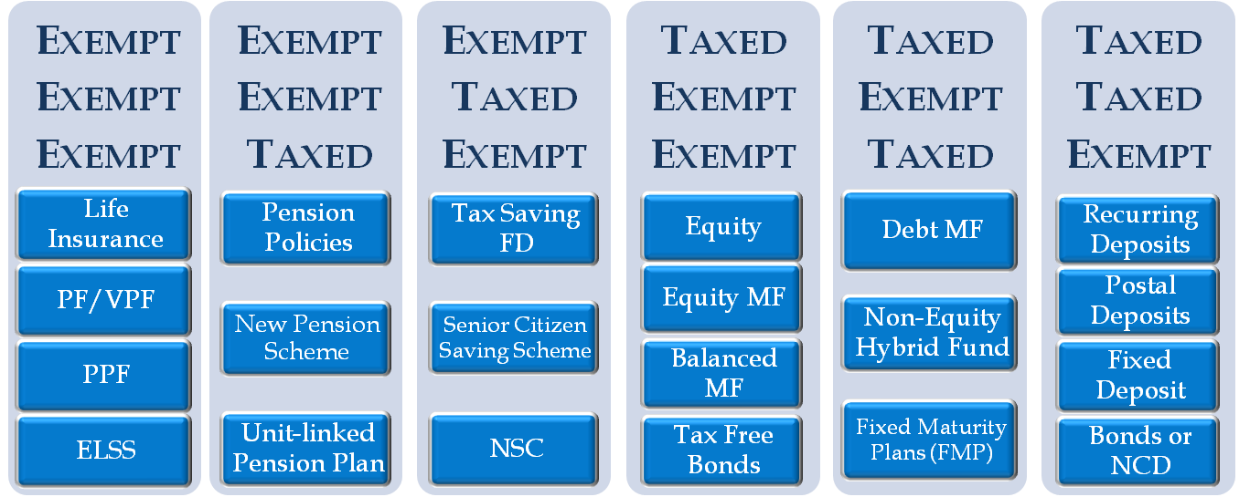
Life Cycle Tax Treatment*: Investment Products
* Tax Treatment at:
Investment
Growth
Withdrawal
80(C) Compliant Products:
Immediate tax savings: Immediate Return (If tax benefit is availed): 10% - 30% based on the Tax Slab
Deferred Returns: 5% - 15% based on the Investment Instrument
Notes:
In India, There are different systems of tax for various investments made for saving Tax.
The investment made has three stages – namely – Money Invested – Money Grows – Money Withdrawn
In today’s session we will not discuss any investment which does not give Tax benefit In the first Stage e.g. Normal Bank FD & Kisan Vikas Patra
EEE - Investment eligible for tax benefit at the time when investment is made, the money which has grown/interest accumulated is not taxed and the amount when withdrawn is not taxed. PF, PPF, VFP & Insurance plans with sec 10(10)(D) are the main instruments where EEE is applicable
EET - Investment eligible for tax benefit at the time when investment is made, the money which has grown/interest accumulated is not taxed and the amount when withdrawn is taxed. Monthly Pension Plans is an example
ETE - Investment eligible for tax benefit at the time when investment is made, the money which has grown/interest accumulated is taxed and the amount when withdrawn is not taxed. National Saving Certificate(NSC) and Tax Saving Fixed Deposit are examples
TEE:- Investment which are not eligible for any tax benefits when investment is made whereas the money which has grown in the form of Interest/dividend is exempt from Tax. Moreover, at the time of sale, the capital gain is also exempt from tax provided conditions as mentioned in the law has been fulfilled. i.e Equity MF ( long term).
TET:- Investment which are not eligible for any tax benefits when investment is made whereas the money which has grown in the form of interest /dividend is exempt from tax. Moreover, at the time of sale, capital gain is taxable as a short term or long term , depending upon the period of holding.
TTE:- Investment which are not eligible for any tax benefit when investment is made. Also the return in the form of interest is taxable. Interest income from these options are liable for TDS deduction except NCD. Hence, out of all these options, NCD is more beneficial for those taxpayer who have taxable income below the exemption limit i.e. Rs 2 lakh. Finally the amount is not taxable at the time of withdrawal.

Slide 20
9 Reasons for getting Tax Notice
Not giving correct PAN before the new job or FD could lead to penalty of Rs 10,000 and TDS at higher rate.
Not filing of Income Tax returns when annual income is above Rs 2,00,000 could lead to interest and penalty of upto 300% of the outstanding tax due.
Not Filing tax return on or before due date could lead to penalty of Rs 5000 and lose the right to carry forward of losses, if any.
Not declaring the previous employer income will lead to interest and penalty upto 300%of tax evaded.
Submission of form 15 G/H for non deduction of TDS on fixed deposit to bank but combined interest income is above taxable limit of Rs 2 Lacs.
Non declaration of interest on fixed deposits , saving accounts , post office savings and PPF etc.
Not replying or ignoring Intimations /notice received from the Income Tax Dept.
Not getting refund from the Dept due to wrong communication address and MICR/IFSC Code.
Not providing landlord PAN while claiming HRA for annual rent above Rs 1 lacs.
Notes:
Every employees has the duty to provide correct PAN details to his current employer. In absence of same, employer will deduct the TDS at a flat rate of 20% instead of normal tax slab rate. For e.g in case of employee having taxable income of Rs 10 lacs, Tds of Rs 1.6 lac will be deducted instead of Rs 1.3 lacs. On the other hand, taxpayers also need to mention correct PAN at the time of filing of return otherwise they may receive a penalty notice of Rs 10000.
2. It is mandatory to file Income tax return when gross total income exceeds Rs 2 lacs before claiming deduction under chapter VI-A i.e 80C etc . Also the return is to be filed even if there is no tax liability. Now a days, due to automation of system, dept gets information of high value transaction on the basis of PAN details submitted to Bank, share broker etc. which leads to notice from dept regarding non filing of return and finally interest or penalty may be levied i.e upto 300% of the outstanding tax liability.
3. As per law, if you want to claim losses under the head business or profession, loss under the head capital gain etc under current filing and want such losses to be carried forward to next assessment year, it is mandatory to file return within the due date i.e. 31st July. In absence of same, you will lose the right to claim such losses and its carried forward to next assessment year . Hence, this will lead to high income tax liability at the time of filing of return. In case you will file the return after 31st March i.e. FY 2013-14- after 31st March,2014, you may receive a penalty notice of Rs 5000.
4. Normally, employee has the tendency not to provide details of income from previous employer to new employer. This would lead to lower deduction of TDS amount by new employer and additional interest liability at the time of filing return. In some of the cases, also the taxpayer do not provide any details of income from previous employer while filing income tax return. This would lead to notice for incorrect filing which will ultimately result in additional interest along with penalty upto 300% of outstanding tax liability.
5. Incorrect submission of form 15G/H for non deduction of TDS on interest income from FD would lead to low deduction of TDS amount from bank . This would lead to additional interest penalty at the time of filing of return and notice from dept regarding wrong submission of details.
6. Generally, taxpayer has the tendency not to show taxable income such as FD interest income on accrual basis, Saving bank interest and exempt income such as PF amount, Interest income from PPF etc while filing income tax return. This will lead to notice for incorrect filing resulting additional interest or penalty upto 300% of outstanding tax demand.
Sometime, taxpayers do not bother about the Notice/Intimation which he has received from the dept or do not reply the notice in time. This will lead to notice like adjustment of refund with the previous year demand, Scrutiny notice u/s 143(2) , Income escaping notice etc.
It is always better to provide correct bank account number along with IFSC code at the time of filing of return. Incorrect details will result in delaying processing of refund or possibility of crediting the amount to wrong account. Sometimes, taxpayer prefer refund option through cheque which may delay processing of refund.
As per new notification in this regard, it is mandatory to provide PAN of the landlord if annual rent exceeds Rs 1 Lacs. In absence of same, declaration to this effect from the landlord is required to be submitted. In absence of same, you would be eligible to claim so much of the HRA exemption which is applicable for annual rent of Rs 1 lacs. Hence, it would ultimately leads to high tax liability

Slide 21
Introduction of New Facility at TaxSpanner.com
Possible to check last 5 years filing status through “My Return Status” Option
Income tax filing i.e. whether online or physical.
ITR-V i.e. date of receipt of ITR-V at CPC.
Demand i.e. detail of assessment year along with demand amount.
Refund i.e. Detail regarding date and amount of refund.
File return with verified option.
Filing of Business Return including income from F & O transactions.
Optimize your Tax Outflow-Minimize expenses on Income Tax
Notes:
Most of the taxpayers either does not registered them self at ITD site or does not know “how to check status after login into account”. To help taxpayers from cumbersome process, TaxSpanner provides facility to its registered users to check their return status. They can also check demand or refund status for last 5 fYs.
To help users to claim correct TDS amount and to avoid further correspondence from dept regarding mismatch in TDS as claimed in return with the details reflected in form 26AS, TaxSpanner has launched new service named “ Verified filing “.
Normally filing of business return is itself a difficult task as we have to take care of all the law provisions. By adding F & O transaction in return, it becomes more difficult and complex to prepare when the number of transaction are on the much higher side. Hence, TaxSpanner provides investor filing through online portal whereby just uploading the transactions, the users may know all the details immediately such as sale, purchase, net profit or loss, if any along with details of open ended transactions.
Tax Planning:-In 2012, TaxSpanner has launched new service named “Tax Optimizer” in which one Chartered Accountant is wholly dedicated to provide you solutions of all Income Tax related queries, preparation of your income tax computation apart from giving assistance for Tax Planning. In tax planning, based on your tax computation , CTC figure and pay slip, Chartered Accountant will suggest you various investment/exemption option through which not only you can increase your take home salary but also gives you an opportunity to minimize your tax liability so that your financial goals will be achieved in time.

Slide 22
THANK YOU

Slide 23
ANNEXURE

Slide 24
Exempted Income (Contd...)
Leased Accommodation
Accommodation
Owned by Employer
Taken on Rent/ Lease by Employer
Value of perquisite is determined by population of place of residence
Taxable:
Amount of rent paid/payable
OR
15% of salary,
whichever is lower
Taxable:
If Population is 25lac + => 15% of salary
If Population is 10-25 lakh => 10% of salary
If Population is upto 10 lakh => 7.5% of salary
In both the above cases, the value of perquisite would be reduced by the rent, if any, actually paid by / recovered from the employee
Notes:
House Rent allowance is a very important part of your CTC. And what is more important is that you tune your HRA to the actual rent paid by you, be it more or less. For instance, if you are paying 18,000 as rent, but are receiving only 12,000 as HRA, make it a point to get your salary restructured to increase the amount allocated to the HRA component. This will bring down your taxable income significantly. Two more things: even if you are living in the house owned by your parents, you can still claim HRA. Of what I know, how it usually works in most of the families is that everybody contributes to the monthly spending – be it on grocery, electricity or other utilities. To take full advantage of this contribution, you can contribute this amount as rent paid to your parents and claim it as HRA.
You can claim both HRA and home loan benefit if you are living in rented property and have taken a loan for constructing a house in a different city. In fact, both these benefits can be claimed even if rented accommodation and owned property (self occupied) is located in the same city, subject to some conditions (here you can give example of a condition).
2. If you incur expense on your family’s health, you are entitles to tax benefit. You can claim tax free reimbursements of Rs 1250p.m. on submission of actual bills of chemist, doctor, tests incurred for your family (spouse, children, dependent parents , brother or sister) Generally, there is a misconception that medical reimbursements are dependent on the number of working days. However, the law has not restricted its purview to the number of working days. As per law for general medical reimbursement, Rs 15000 is the maximum tax break that an individual can avail against actual supporting documents.
3. As transport allowance, Rs 800/month is allowed by law for commuting between place of residence and office> In case your company is providing you cab facility, it may not offer the additional Rs 800 allowance. Though, as per law, you can still claim this exemption. The law has specified this limit for a particular purpose, but has not mentioned by what means you should commute. Further, this claim of Rs 800, you do not need to submit any bills. So, make sure that you are including it in your salary package, if the car lease perquisite has not been availed.
4. For those in field jobs, there is another tax benefit in the form of conveyance allowance. All you need to do is keep a log book and make a note of all visits to vendors, suppliers, customers, etc. and claim conveyance allowance. The limit of this claim is generally prescribed by the employer, and is not set by law. As per law, the amount spent on official purpose is allowed as conveyance allowance. Usually, the per km fare is given to you, and as per the seniority level, the mode of conveyance may vary from bus to auto to taxi. Usually, it’s the sales team, journalists and delivery boys who are on the field for official duties only. travel Though in case the expenses exceed the allowance limit, you can’t claim the total amount of expenses.
Employees who are not open to take risks are advised to invest in provident fund since it is one of the safest investments. Also, it is a great retirement benefit. The lump sum amount received on maturity is fully exempt from tax and you can even claim deduction of 80C every year upto Rs 1 lakh by investing in Public Provident Fund. Every year, 12% of your basic salary can be contributed towards provident fund by you and your employer. Not only is this contribution by your employer fully exempt from tax, even the interest earned on PF up to 9.5% is also exempt from tax. If your basic salary is more than 6500/-p.m , you can not force your employer to deduct the PF. In that case it totally depends on the will of your employer to deduct the PF or not. If you ask your employer to increase your basic salary, you would be able to invest more in PF since the maximum limit is 12%of basic salary. Even on retirement you would get the higher amount because your employer will also contribute more towards PF. Due to enhancement in basic salary, you will be required to invest less in other savings to completely exhaust the deduction of Rs 1 Lakh u/s 80C. You will also be benefitted in claiming more amount of HRA exemption through this.
If you are living in accommodation provided by the company and feeling that you did not get any benefit of HRA, government has also given a benefit to those residing in company-provided accommodation. If the accommodation is taken on lease, 15% of basic or lease rent paid will be added in your salary as taxable income. If the accommodation is owned by the employer, tax liability will depend on the population of the city you are living in.
Car lease can, for some tax payers, become a very powerful weapon for tax optimization. Employer owns the car lease deed and the car is used by you for official and personal purpose. Your taxable salary gets reduced significantly. All that’s taxable is Rs 1800 p.m. of perquisite value.
Now comes another benefit which salaried people like you can claim, but are not aware of . If you are using your phone for both official and personal purposes, do take the tax advantage of expenses incurred for official purposes. These will be reimbursed by employer to you after verifying the expenses declared. It’s a tax free perquisite.
Have you guys heard about food coupons? So, food coupons with value up to Rs 50 per meal are tax-free. Food coupons are tax free perquisites for working days only. E.g. An employer gave Rs 3000 per month for food coupons and you worked for 22 days in a month then 2200 will be tax free perquisite (i.e. Rs 50 x 2 meals x 22 days) and Rs 800 will be taxable. When company provides you these coupons, you need to declare that you will not sell it as benefit under tax law. Food coupons are non-transferable. Food coupons for snacks, tea, etc. in working hours are tax free. There is no limit for snacks coupons.
Like your colleagues who throw a warm farewell for you when you leave after putting in substantial years, your employer too has a small, but significant, way of singing 'he's a jolly good fellow' to reward you for your service to the organization . You become entitled to a gratuity on resignation or on retirement after five years or more of service. If you leave the organization before 5 years, then whole amount will remain taxable . As per the law, the gratuity amount is 15 days' wages multiplied by the number of years put in by you. As per the formula under the Act, gratuity up to Rs 10,00,000 is exempt from taxes. If you increase your basic salary, your gratuity contribution will also get increased and you will get a huge lump sum amount which will be tax free as government has increased the limit upto Rs 10,00,000. Gratuity helps in strengthening your finances.

Slide 25
Exempted Income (Contd...)
Car Lease
Car Running and Maintenance, expenses are borne by employer
Ownership
Employer
Employee
Official Purposes
Personal Purpose
Official & Personal Purposes
Personal Purpose
Official & Personal Purposes
Not Taxable
Fully Taxable
Taxable:
Car < 1.6 cc = Rs.1800/month
Car > 1.6 cc = Rs.2400/month
Taxable = Actual Expense less recovered from employees
Exempt:
Car < 1.6 cc = Rs.1800/month
Car > 1.6 cc = Rs.2400/month

Slide 26
Exempted Income (Contd...)
Car Lease
Driver’s Salary, expenses are borne by employer
Ownership
Employer
Employee
Official Purposes
Personal Purpose
Official & Personal Purposes
Personal Purpose
Official & Personal Purposes
Not Taxable
Fully Taxable
Taxable = Rs.900/month
Taxable = Actual Expense less Reimbursed
Exempt = Rs.900/month

Slide 27
Illustration on Interest Income
Mr. A has salary income of Rs. 12 Lakh and interest on Fixed deposit Rs.90,000. Bank deducted tax on FD interest of Rs. 9000. What will be his Tax liability?
Computation of Income Tax | (In Rupees)
Taxable Income from salary | 12,00,000
Add: Income from other sources (Interest Income) | 90,000
Total Income | 12,90,000
Tax on Income | 2,23,510
Less: TDS deducted by Bank | 9,000
Net Tax Payable | 2,14,510
Notes:
Interest on Fixed deposit is taxable, Mr. has salary income of Rs. 12 lac and FD interest income of Rs. 90,000 and bank has deducted tax of Rs. 9000, So his total taxable income will be 12,90,000. Taxes computed as per slab rate on 12,90,000 is Rs. 2,23,510. Rs. 9000 of taxes were already deducted by Bank so remaining tax liability he has to pay i.e. 2,14,510.

Slide 28
Illustration on HRA Exemption
Mr. A is residing in Delhi (metro city as per law), and is currently paying rent of Rs.20,000 per month. His CTC comprises: Basic Pay = Rs.420,000 p.a, D.A. = Nil and HRA = Rs.200,000 p.a.
Minimum of the following is exempt: | (In Rs.)
50% of Basic salary ( Basic + D.A) | 210,000
HRA component in the Salary Structure | 200,000
Rent paid less 10% of Basic Salary ( Basic + D.A) | 198,000
HRA Exemption | 198,000
Notes:
Please note if you are residing in non metro cities then 40% is applicable on Basic salary. As Mr A is lives in Delhi and pay the rent amount Rs.20000 p.m and in this case Mr. A has to declare the pan of his landlord to claim the exemption amount (If pay the rent more than Rs.15000).
Rent Paid- 10% of Basic salary= (Rent Per month*12) – ( 10% of ( Basic+ D.A))
240000-42000 = 198000.

Slide 29
Illustration on House Property Income (Self Occupied)
Mr. A has 1 house property which is self occupied by him. He has taken a loan of Rs. 30 lakh for purchasing the property and is paying interest of Rs. 2 Lakh annually to bank. He has also paid municipal taxes of Rs. 5000
His Income from House Property will be: | (In Rs.)
Rental Income | NIL
Less: Municipal Taxes paid during the year | NIL
Net Rental Income | NIL
Less: 30% standard deduction | NIL
Less: Interest paid on loan taken for Purchasing/Constructing House | 2,00,000
Net Taxable Rental income | (1,50,000)
Notes:
Say you have a purchased a property with 30 lac of loan which is self occupied by you, and you have paid interest of Rs. 200000 and municipal taxes of Rs. 5000, but maximum amount which can be claimed as interest deduction is 150000 and no municipal taxes will be deducted in case of self occupied property. Now you have negative income from house property, which will offset your taxable salary income, and you will be benefited.

Slide 30
Illustration on House Property Income (Let out)
Mr. A has 1 house property which is given on rent of Rs.5000p.m. He has taken a loan of Rs. 30 lac for purchasing the property and is paying interest of Rs. 3 Lac annually to bank. He has also paid municipal taxes of Rs. 5000 .
His Income from House Property will be: | (In Rs.)
Rental Income | 60,000
Less: Municipal Taxes paid during the year | 5,000
Net Rental Income | 55,000
Less: 30% standard deduction | 16,500
Less: Interest paid on loan taken for Purchasing/Constructing House | 3,00,000
Net Taxable Rental income | (2,61,500)
Notes:
Say you have a purchased a property with 30 lac of loan which is self occupied by you, and you have paid interest of Rs. 200000 and municipal taxes of Rs. 5000, but maximum amount which can be claimed as interest deduction is 150000 and no municipal taxes will be deducted in case of self occupied property. Now you have negative income from house property, which will offset your taxable salary income, and you will be benefited.

Slide 31
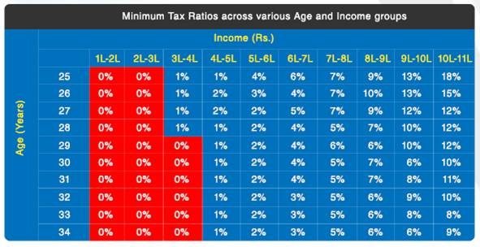
Tax Ratio: How are you placed?
Compare your tax ratio with the tax ratio in the box belonging to your income and age group
Are you paying more tax than your peers ?
Note:
The percentage figures in the table above represent the average of tax ratios of
ITR filers falling in the minimum 10% of each category.
Notes:
Measured in percentage, it can be easily calculated by dividing your tax paid and salary. According to a study conducted by TaxSpanner, the Tax Ratio of taxpayers with salary Rs. 7 lakh and 29 years of age ranges from 3% to 7%, thereby implying that some taxpayers in this group are paying just Rs. 21,000 (3%) as tax and some are paying Rs. 49,000 (7%) as tax. Ideally, if every individual is tax efficient in this group, then he/she should have tax ratio of 3% only!
You may want to calculate your tax ratio right now and see how well you are doing with optimization. There are a few reasons for the same, most of them are related to poor tax planning, investment in non-tax efficient schemes, and lack of matching investment to financial goals. It seems that when it comes to tax matters, we are not as smart as we think we are.

Slide 32
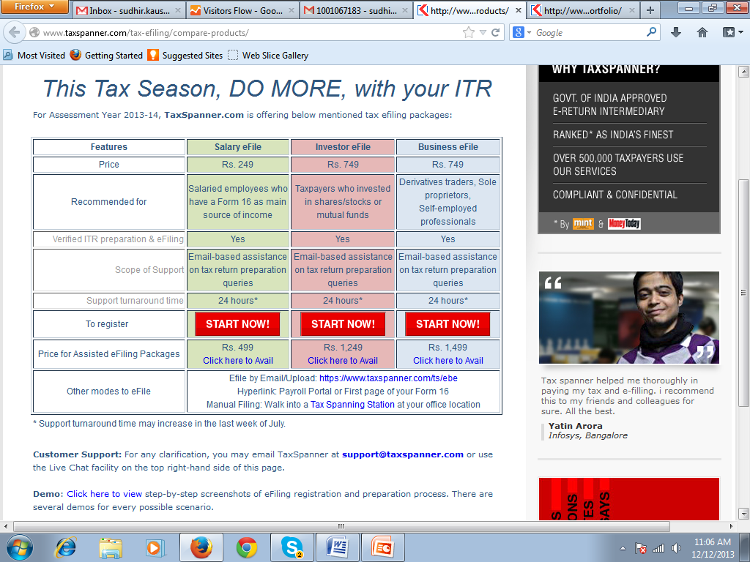
Notes:
You can compare products at http://www.taxspanner.com/tax-efiling/compare-products/

